Slide 1
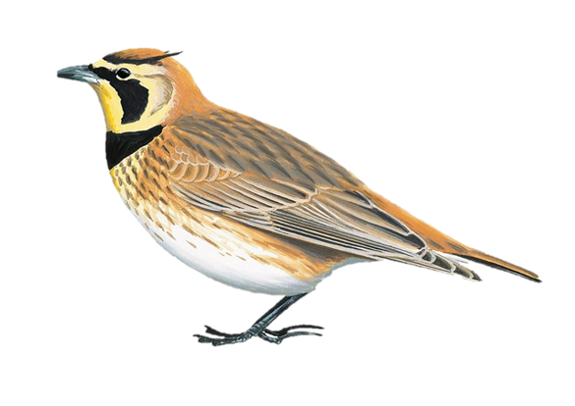
Using RStudio + spsurvey to Create A Spatially Balanced Survey Frame for Estimating Streaked Horned Lark Abundance in the Willamette Valley
Presented by
Matt Stevenson,
CORE GIS
CUGOS Spring Fling
April 21, 2023

Slide 2
Why Did We Do This?
The Streaked Horned Lark (Eremophila alpestris strigata) is listed as Endangered by Washington State and Threatened by the US Federal government

Slide 3

Two Important Questions
Where are the larks?
How many larks are there?

Slide 4
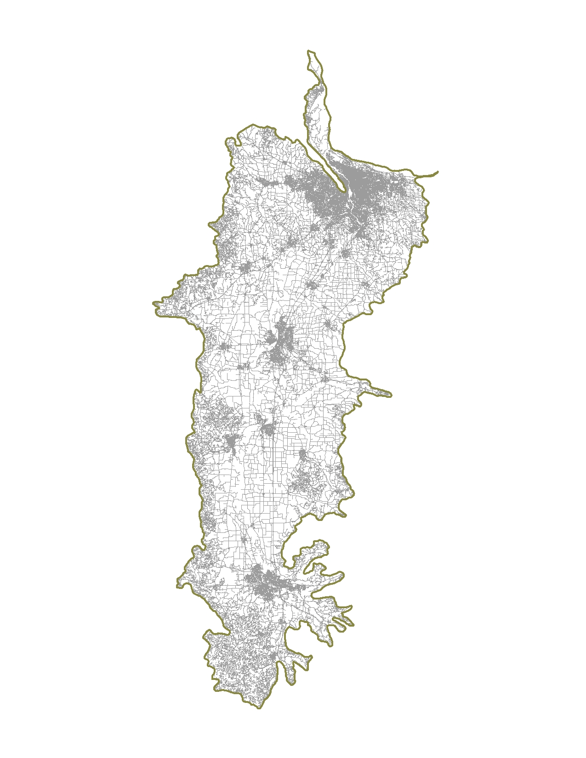
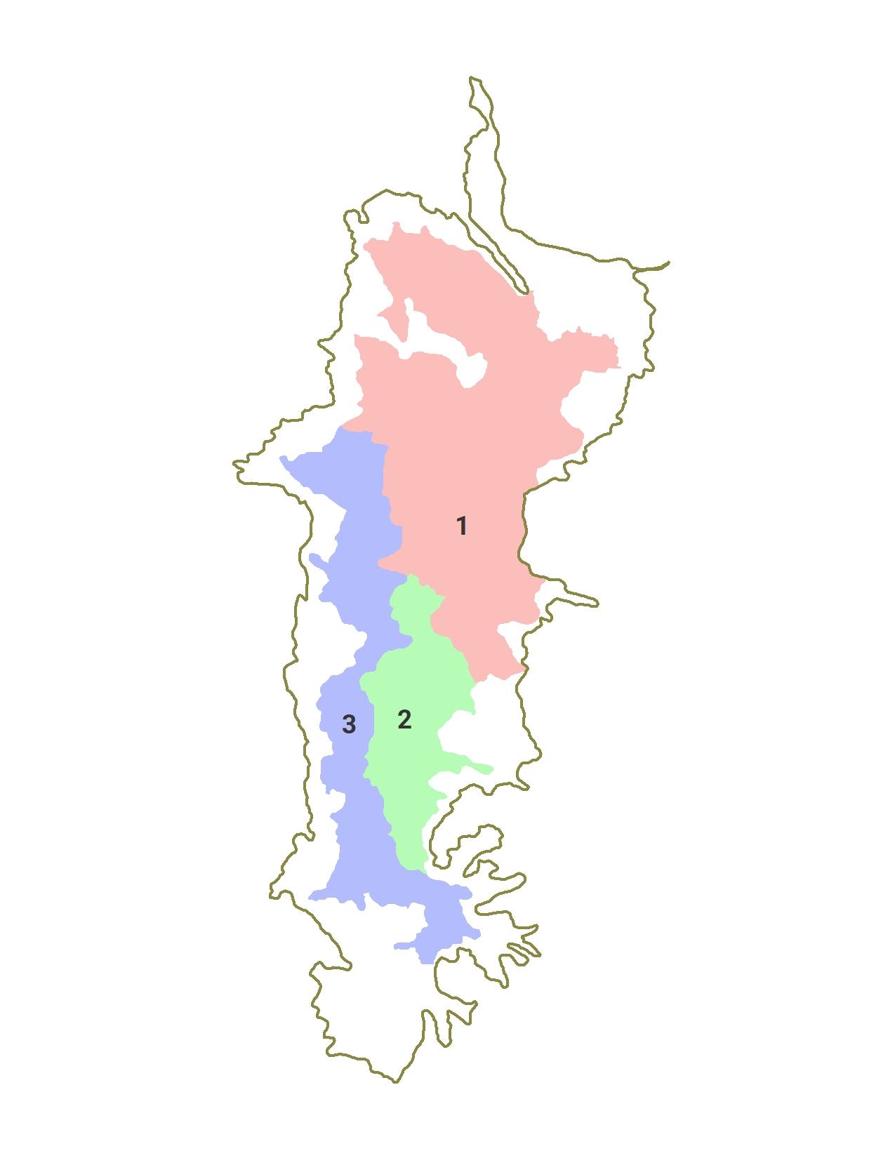
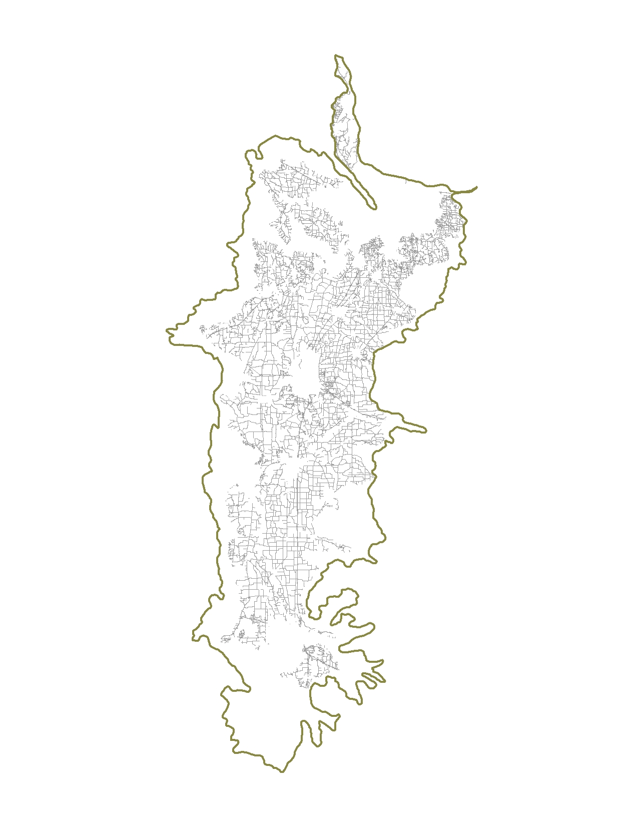
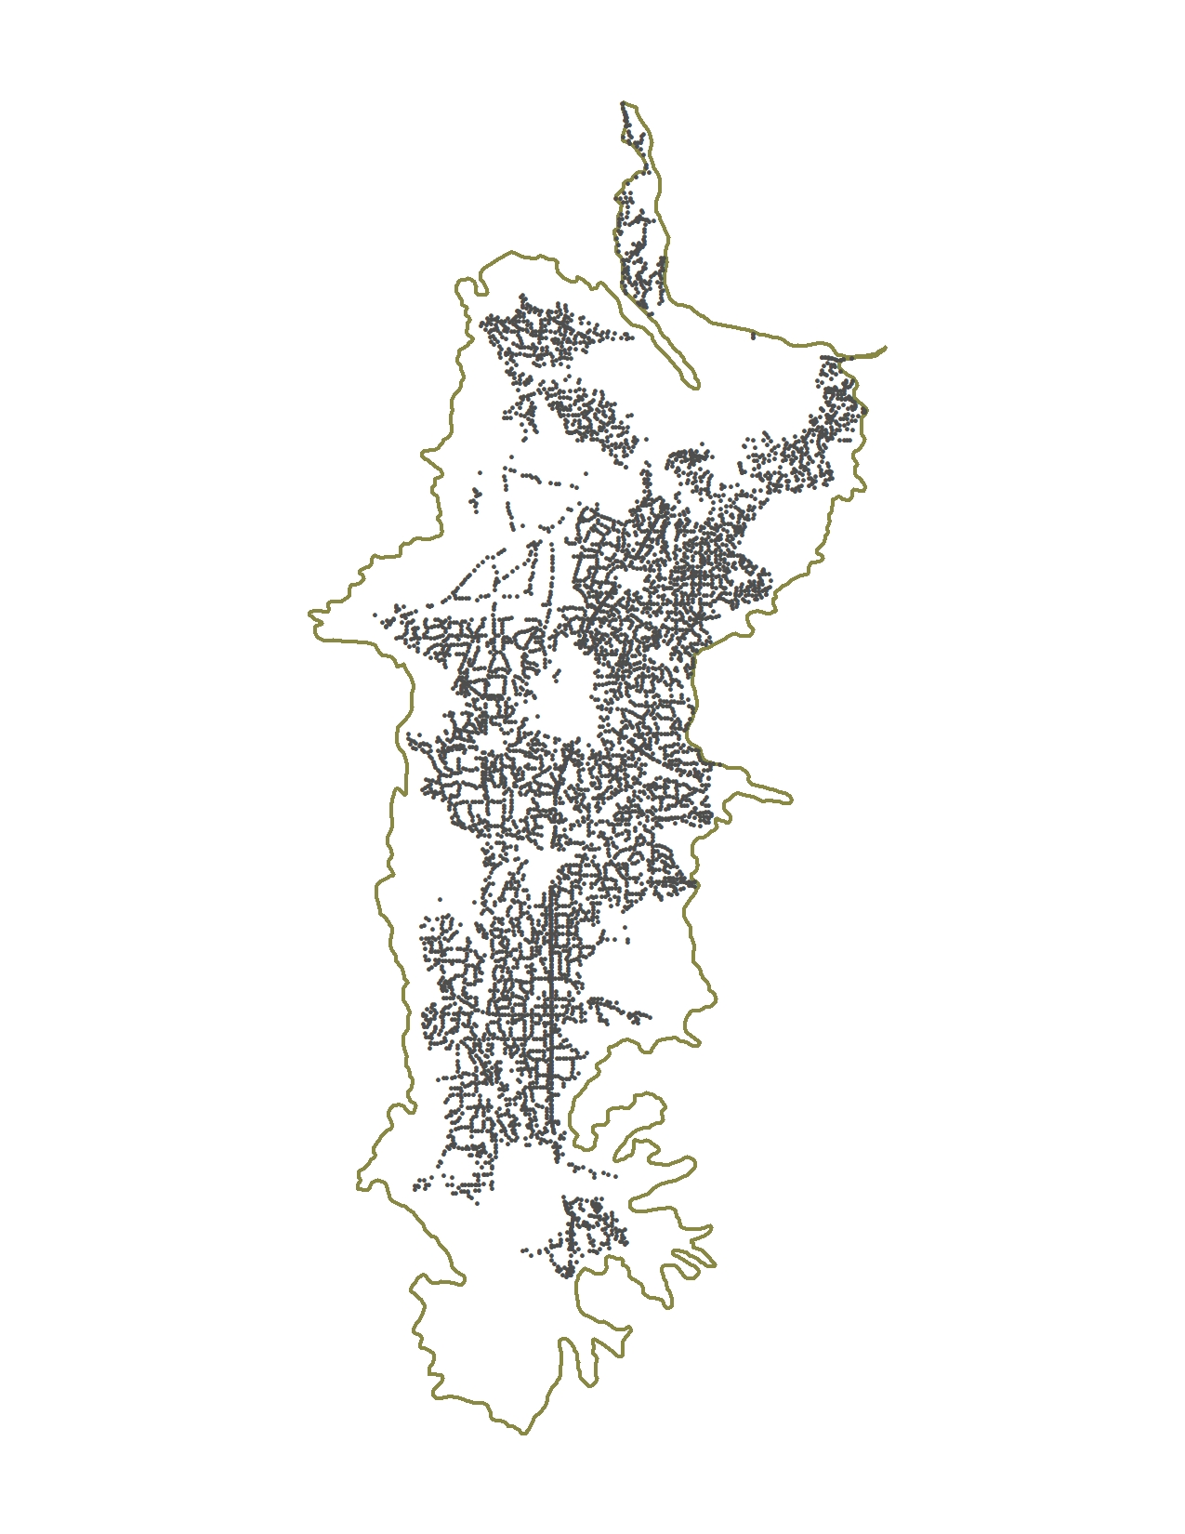
Roads
Recovery Zones
RemoveUGAs
Distribute Points
Roads clipped to study area
Removed interstates, state highways, and all roads within UGAs
Removed roads outside recovery zones
Limited to areas below 800’ elevation
1 = North Willamette
2 = Southeast Willamette
3 = West Willamette

Slide 5
Creating a Spatially Balanced Sampling Frame
Random samples are not appropriate for extrapolation¹
Larks have opinions about habitat! So we used unequal inclusion probabilities and selected sites proportionally based on the probability of habitat suitability
In our case, least suitable = 0.01, most suitable = 0.99
¹See, for example, Perret et al, Spatially balanced sampling methods are always more precise than random ones for estimating the size of aggregated populations

Slide 6
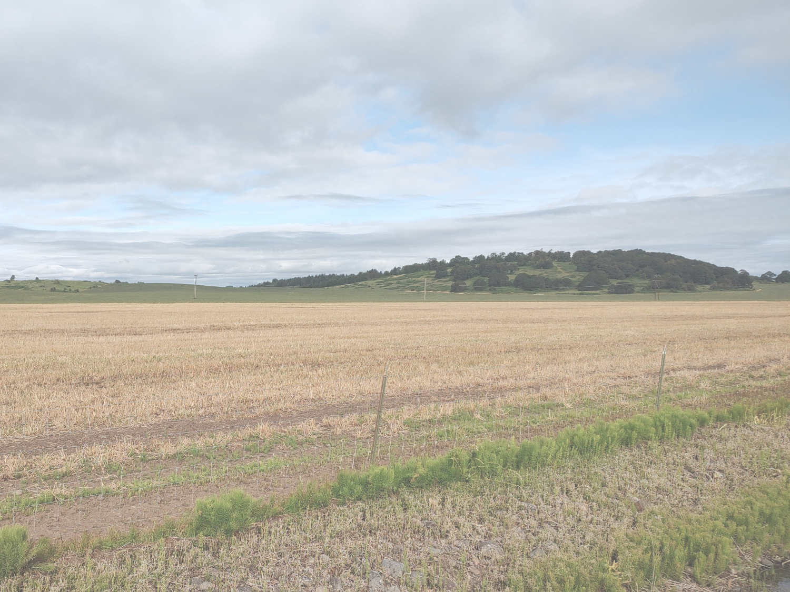
Suitable Habitat

Slide 7
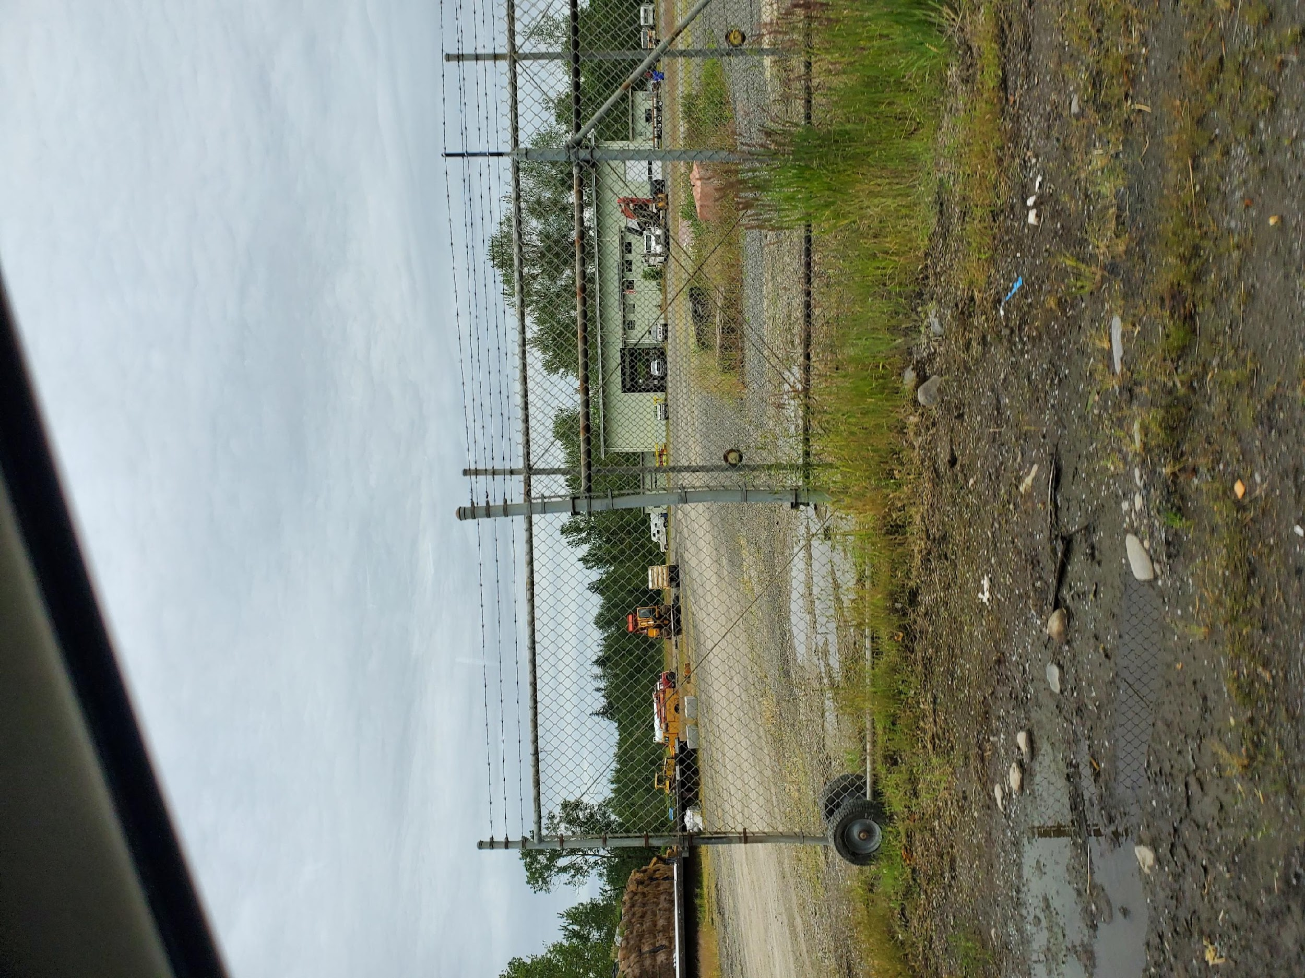
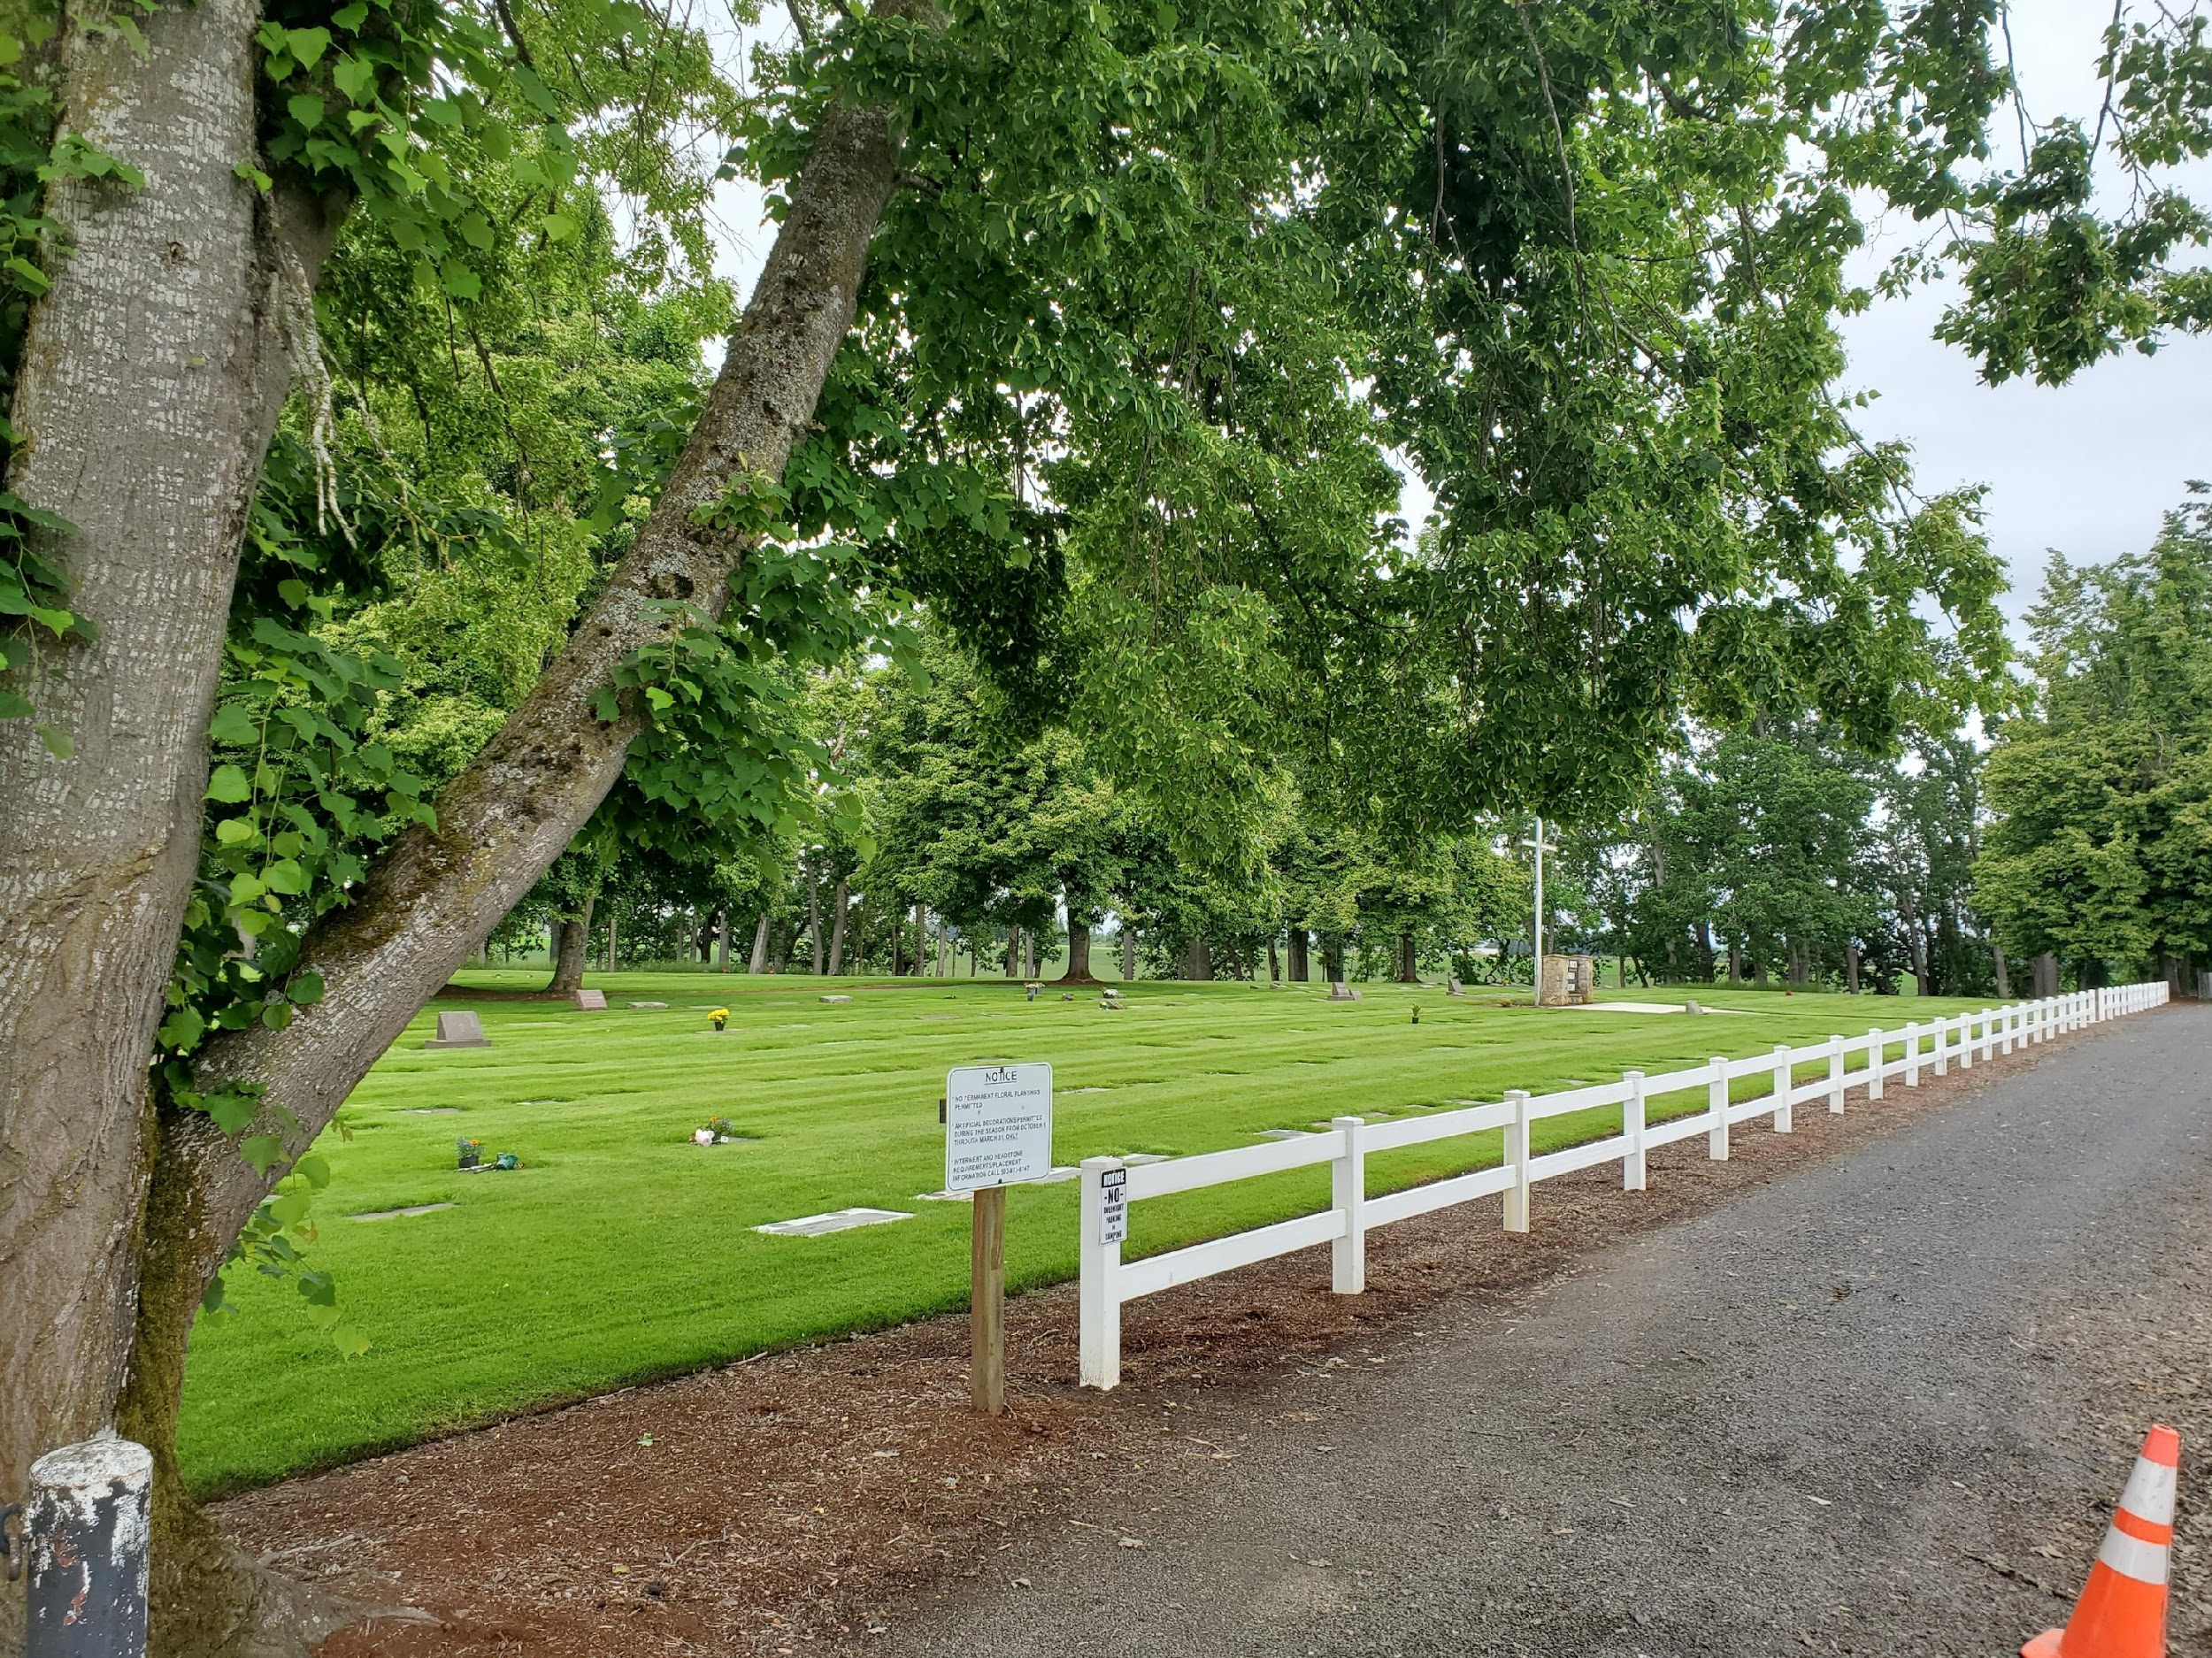
Unsuitable Habitat

Slide 8
How Do You Create a Spatially Balanced Sampling Frame?
By using the Generalized Random Tessellation Stratified (GRTS)¹ algorithm, which is available in the spsurvey package for RStudio
¹Foundational paper by Stevens and Olsen, Spatially Balanced Sampling of Natural Resources

Slide 9
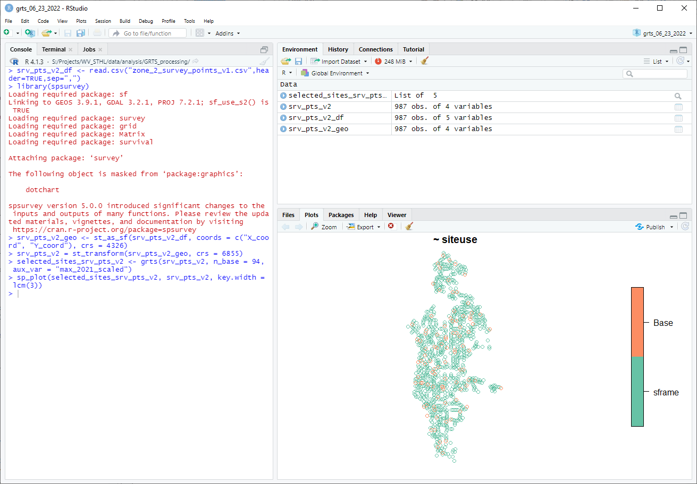
grts = Generalized Random Tessellation Stratified

Slide 10
How To use spsurvey and GRTS in RStudio
Convert points to CSV and load into RStudio
srv_pts_v1_df <- read.csv("zone_1_survey_points_v1.csv",header=TRUE,sep=",")

Slide 11
How To use spsurvey and GRTS in RStudio
Convert points to CSV and load into RStudio
srv_pts_v1_df <- read.csv("zone_1_survey_points_v1.csv",header=TRUE,sep=",")
Load spsurvey
library(spsurvey)

Slide 12
How To use spsurvey and GRTS in RStudio
Convert points to CSV and load into RStudio
srv_pts_v1_df <- read.csv("zone_1_survey_points_v1.csv",header=TRUE,sep=",")
Load spsurvey
library(spsurvey)
Create a geo object from the CSV, being sure to specify your CRS
srv_pts_v2_geo <- st_as_sf(srv_pts_v2_df, coords = c("X_coord", "Y_coord"), crs = 4326)

Slide 13
How To use spsurvey and GRTS in RStudio
Convert points to CSV and load into RStudio
srv_pts_v1_df <- read.csv("zone_1_survey_points_v1.csv",header=TRUE,sep=",")
Load spsurvey
library(spsurvey)
Create a geo object from the CSV, being sure to specify your CRS
srv_pts_v2_geo <- st_as_sf(srv_pts_v2_df, coords = c("X_coord", "Y_coord"), crs = 4326)
Transform GCS coordinates to UTM
srv_pts_v2 = st_transform(srv_pts_v2_geo, crs = 6855)

Slide 14
How To use spsurvey and GRTS in RStudio
Convert points to CSV and load into RStudio
srv_pts_v1_df <- read.csv("zone_1_survey_points_v1.csv",header=TRUE,sep=",")
Load spsurvey
library(spsurvey)
Create a geo object from the CSV, being sure to specify your CRS
srv_pts_v2_geo <- st_as_sf(srv_pts_v2_df, coords = c("X_coord", "Y_coord"), crs = 4326)
Transform GCS coordinates to UTM
srv_pts_v2 = st_transform(srv_pts_v2_geo, crs = 6855)
Select sites using GRTS and the habitat suitability value as the weight
selected_sites_srv_pts_v2 <- grts(srv_pts_v2, n_base = 118, aux_var = "max_2021_scaled")

Slide 15
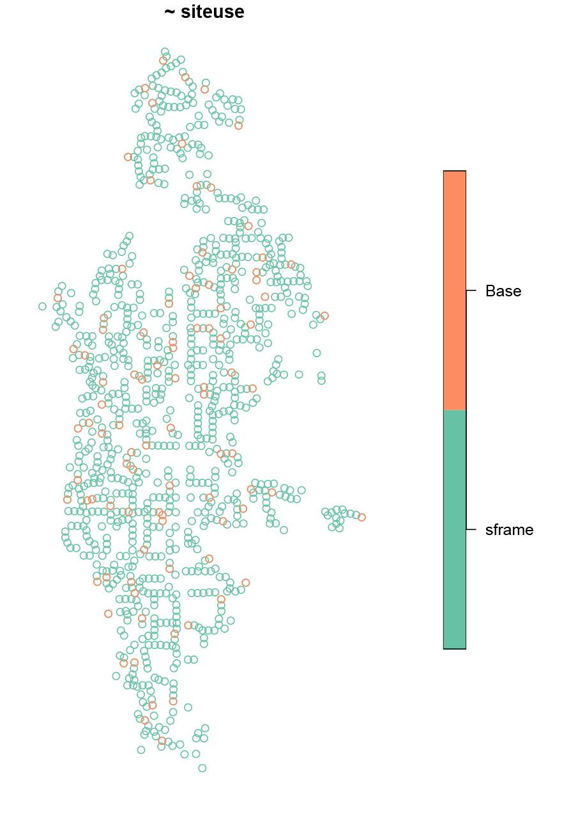
How To use spsurvey and grts in RStudio, continued
Display the results
sp_plot(selected_sites_srv_pts_v2, srv_pts_v2, key.width = lcm(3))

Slide 16
How To use spsurvey and grts in RStudio, continued
Display the results
sp_plot(selected_sites_srv_pts_v2, srv_pts_v2, key.width = lcm(3))
Combine rows from the GRTS sample
proprob_sites_v2 <- sp_rbind(selected_sites_srv_pts_v2)

Slide 17
How To use spsurvey and grts in RStudio, continued
Display the results
sp_plot(selected_sites_srv_pts_v2, srv_pts_v2, key.width = lcm(3))
Combine rows from the GRTS sample
proprob_sites_v2 <- sp_rbind(selected_sites_srv_pts_v2)
Finally, export to shapefile
st_write(proprob_sites_v2, "S:/Projects/WV_STHL/data/analysis/GRTS_processing/proprob_zone_2.shp")

Slide 18
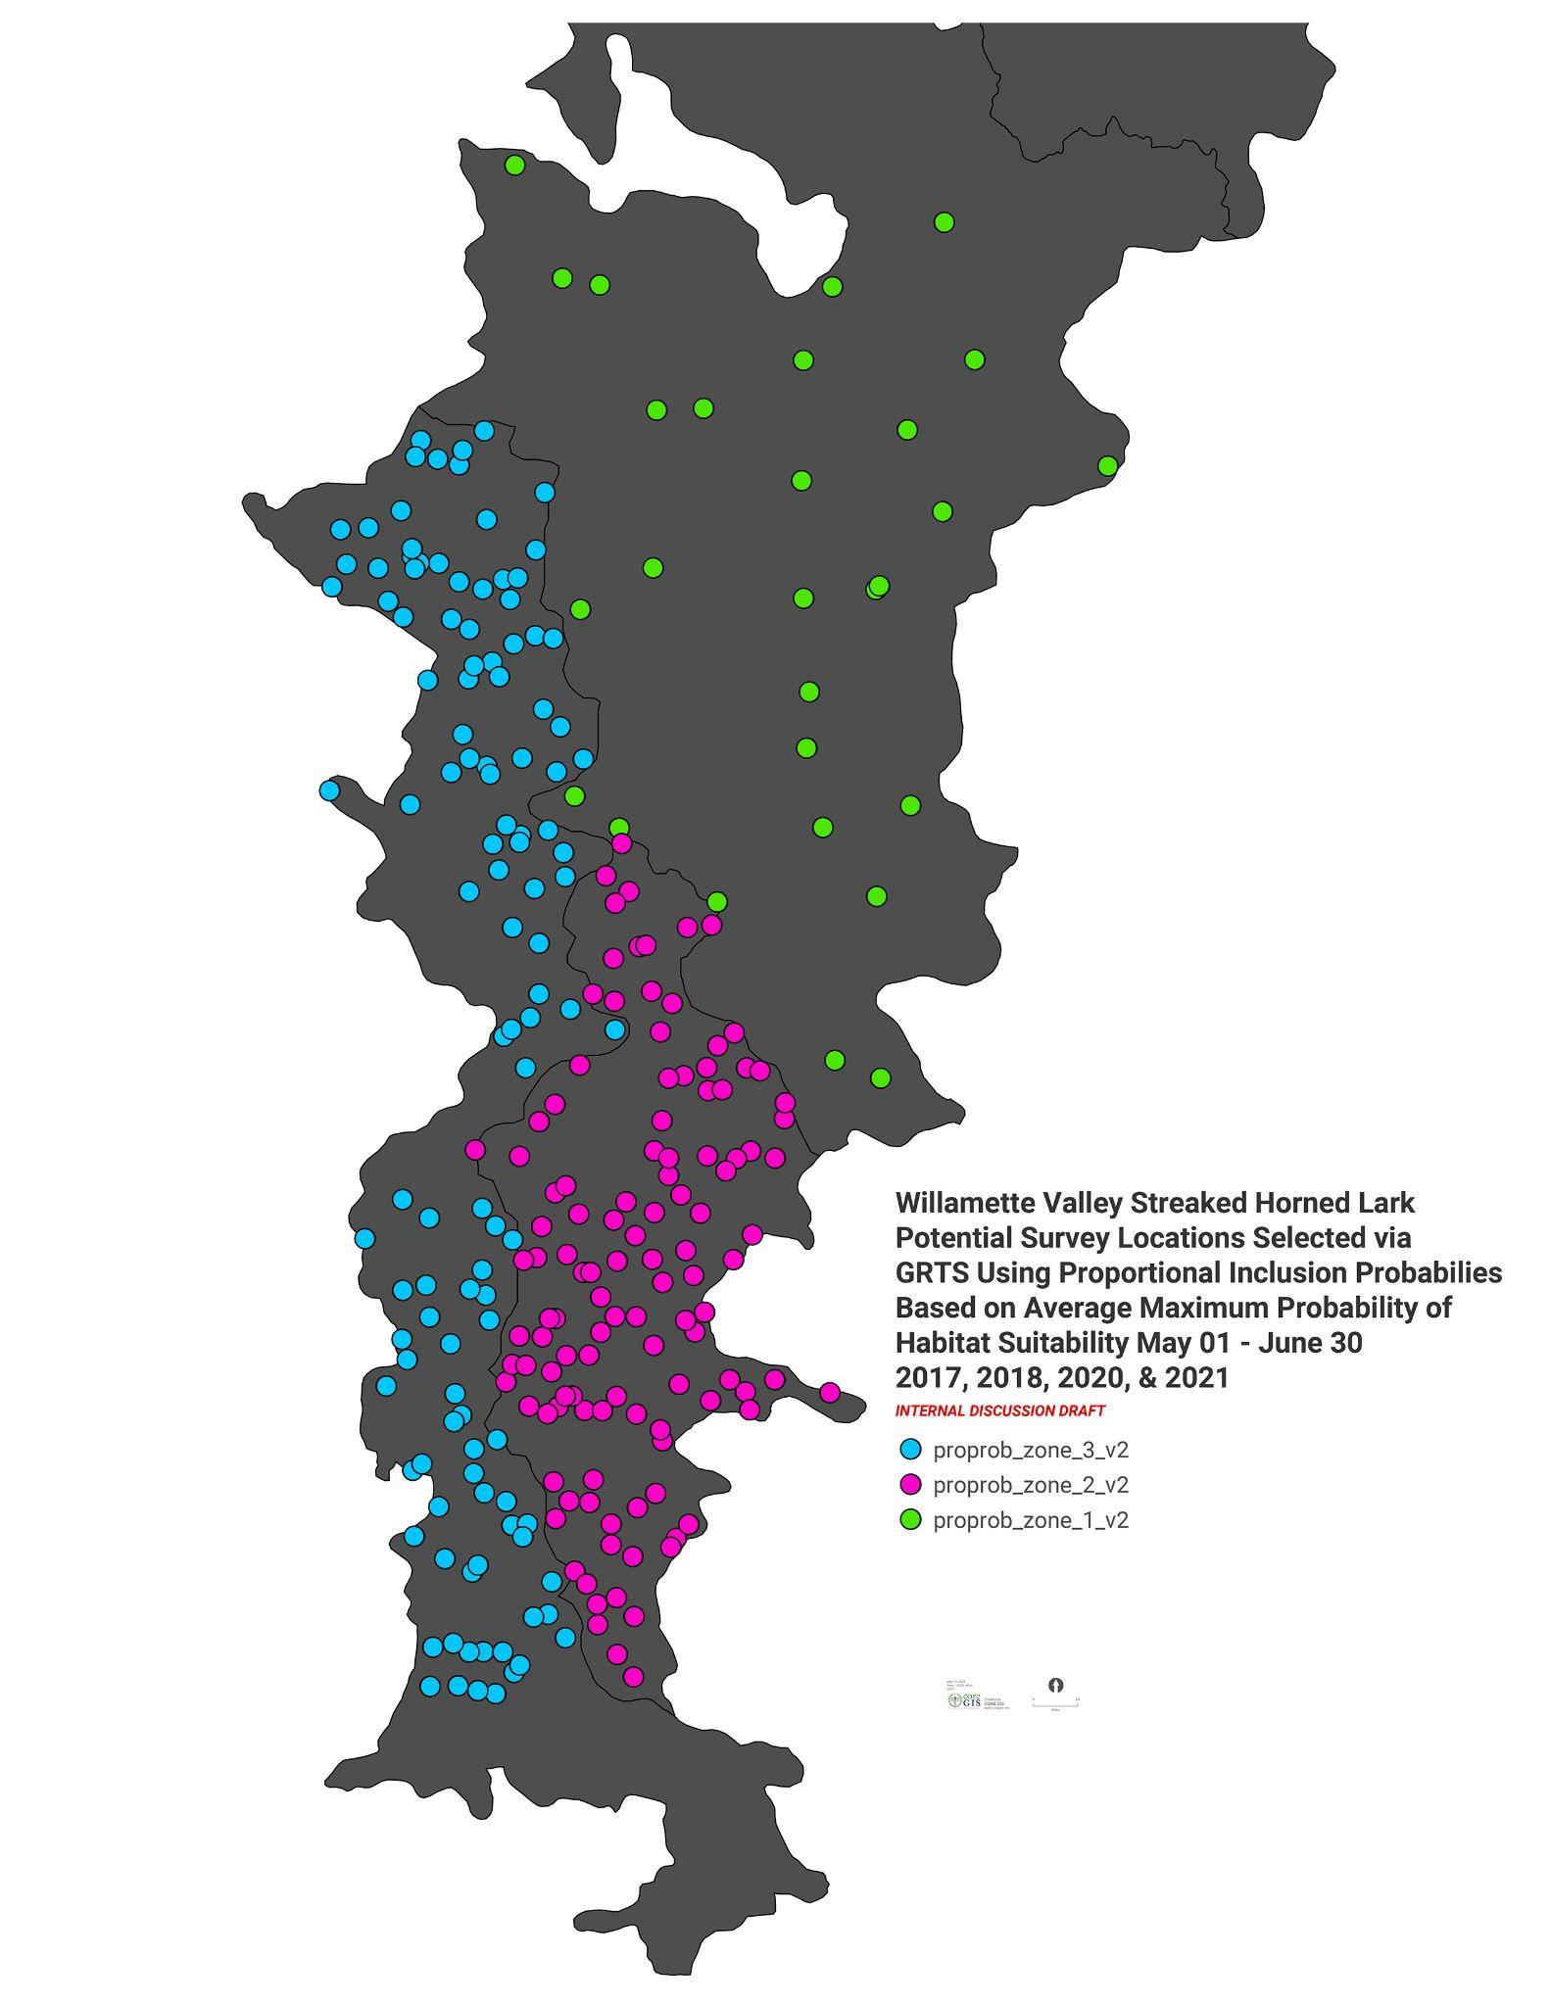
Recap & Results
The recovery zones were used as geographic strata:
Zone Survey Points
North Willamette 28
West Willamette 118
Southeast Willamette 118
grts = Generalized Random Tessellation Stratified

Slide 19
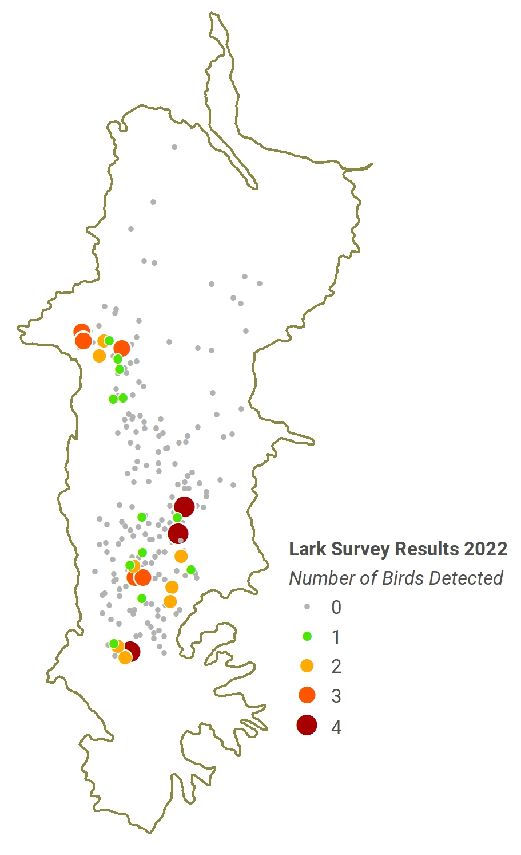
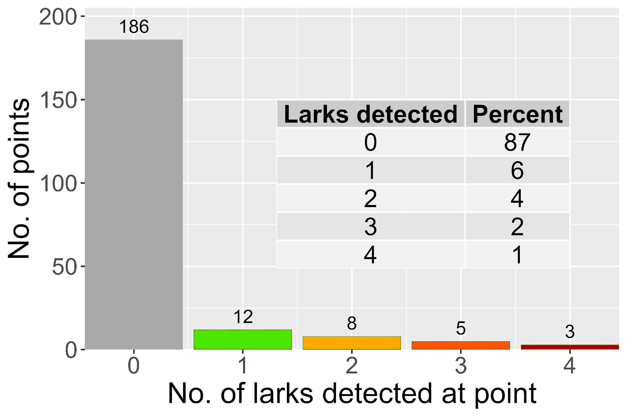

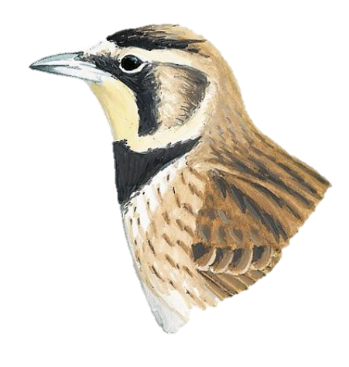


Larks were detected at 28 points (13%) - 55 individuals
?
42
7
6

Slide 20
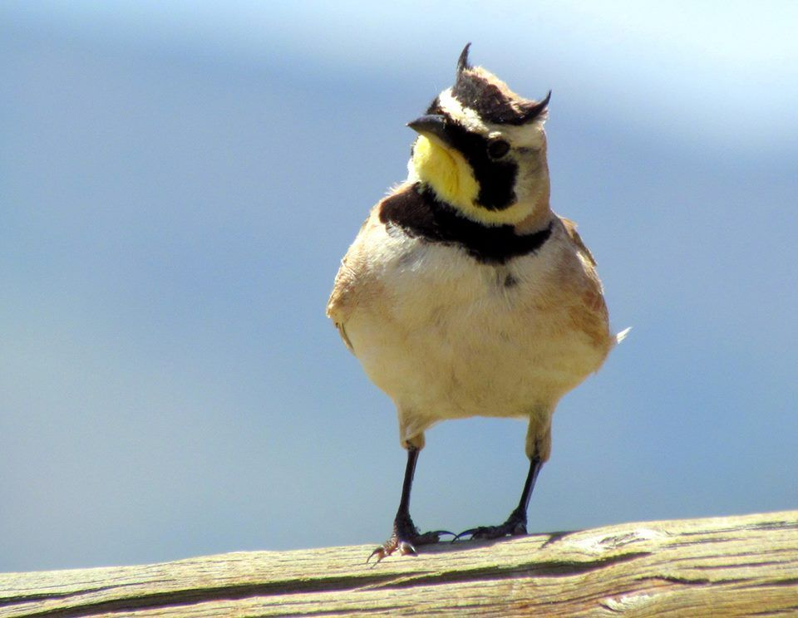
Questions?

